Slide 1

Voting Patterns in TN:
Before and After Redistricting
9th January 2026
Kanak Gupta
Nashville Software School Data Analytics Bootcamp

Slide 2
Introduction
Examining the relationship between congressional redistricting and
county-level voting patterns in Tennessee.
01
03
Two Primary Electoral Outcomes
Comparing TN Counties
Changes in election margins
Changes in voter turnout
02
Experienced changes in congressional
district boundaries
Did not experience boundary changes
Comparing the Elections
2018 Tennessee Governor election (pre-redistricting)
2022 Tennessee Governor election (post-redistricting)

Slide 3
Data Acquisition
Official election results from the Tennessee Secretary of State
County-level results for:
  2018 Tennessee Governor election
  2022 Tennessee Governor election
Congressional boundary data from U.S. Census Bureau TIGER/Line files
County-to-congressional-district crosswalks used to identify boundary overlap
Data Cleaning
Standardized county identifiers across datasets
Filtered results to include only relevant statewide elections
Aggregated vote totals and calculated:
  Election margins
  Total turnout
  Percent change in turnout
Derived a county-level measure of redistricting exposure based on changes in district overlap

Slide 4
Definitions and Key Measures
County-Level Unit of Analysis
  All electoral outcomes are measured at the county level
  Counties serve as the consistent reporting unit across elections and datasets
Redistricting Exposure (County Fragmentation)
  A county is considered fragmented if it intersects with more than one congressional district
  Redistricting exposure is measured as the change in the number of districts intersecting a county between elections
Electoral Outcomes
  Election Margin: Difference in votes between the top two candidates
  Voter Turnout: Total votes cast within a county
  Turnout Change: Percent change in turnout between 2018 and 2022

Slide 5
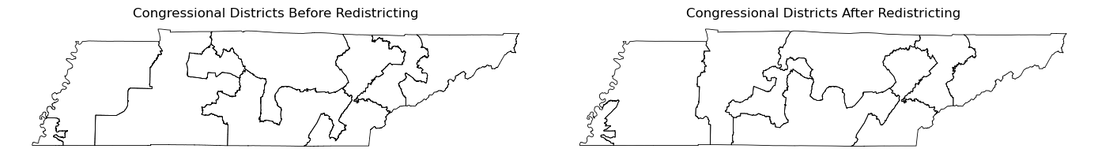
Tennessee Congressional Districts
Before and After Redistricting
Before Redistricting (2012–2021)
District boundaries used for the 2018 election
After Redistricting (2022–Present)
District boundaries used for the 2022 election
Redistricting changed how congressional districts intersect with county boundaries, altering which voters are grouped together across elections.

Slide 6
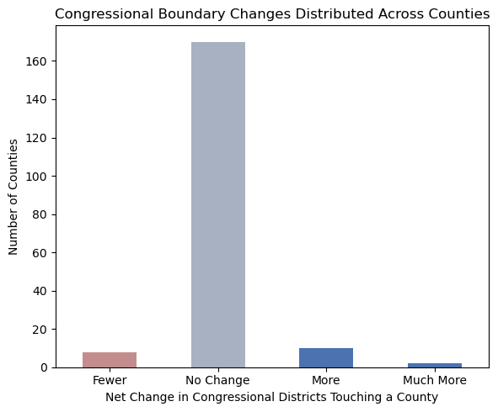
Distribution of County-Level Boundary Changes
Most counties experienced no change in the number of congressional districts touching them, while a smaller subset saw either increased or decreased district overlap after redistricting.

Slide 7
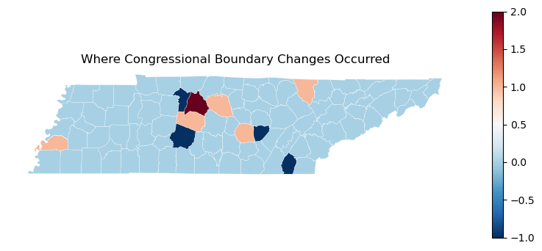
Geographic Distribution of Boundary Changes
Congressional boundary changes were
geographically concentrated, affecting
specific clusters of counties rather than
occurring uniformly across the state.

Slide 8
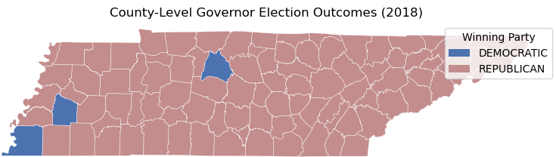
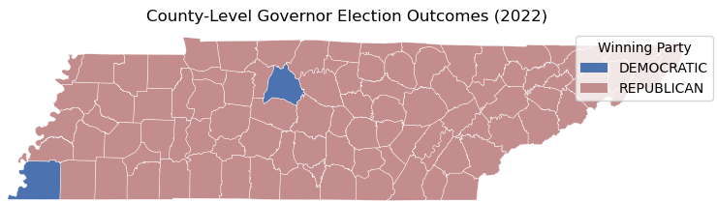
County-Level Governor Results Before and After Redistricting
Across both elections, statewide outcomes remain
stable, while localized
county-level patterns persist over time.
Haywood County’s election outcome changes party during the 2022 Governor election.

Slide 9
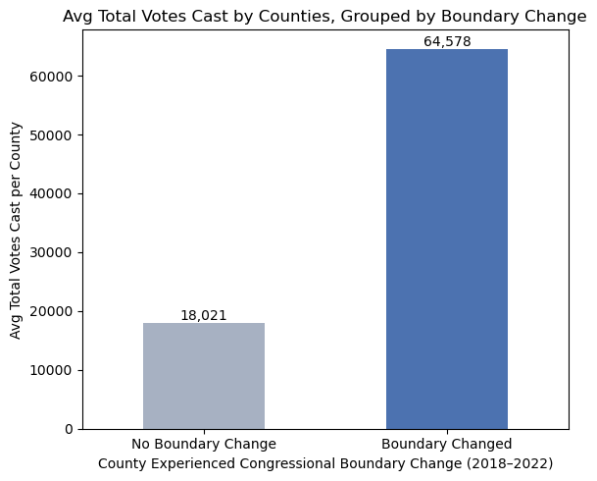
Voter Scale by County Type
Counties affected by congressional
boundary changes tend to have
substantially higher average vote totals
than counties without boundary changes.

Slide 10
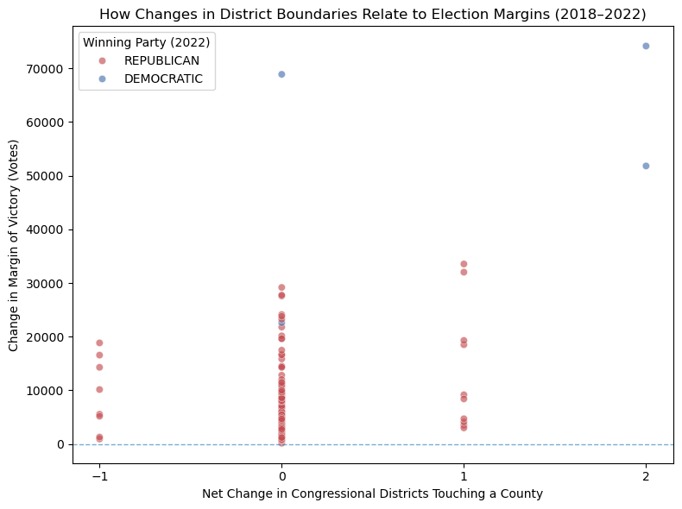
Boundary Exposure
and Election Margin Shifts
Counties that experienced changes in congressional district exposure show greater variability and more extreme shifts in election margins than counties with unchanged boundaries.

Slide 11
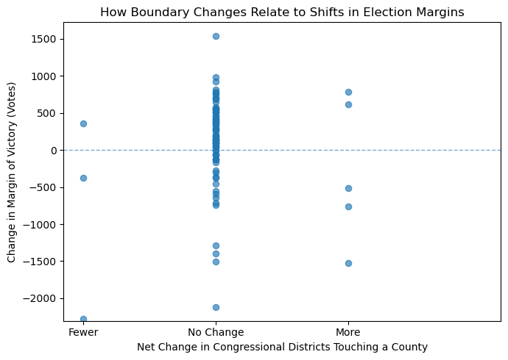
Extent of Boundary Change
and Margin Movement
Counties with either increased or reduced district exposure tend to experience
wider swings in election margins, while
counties with no boundary change
cluster more tightly around smaller shifts.

Slide 12
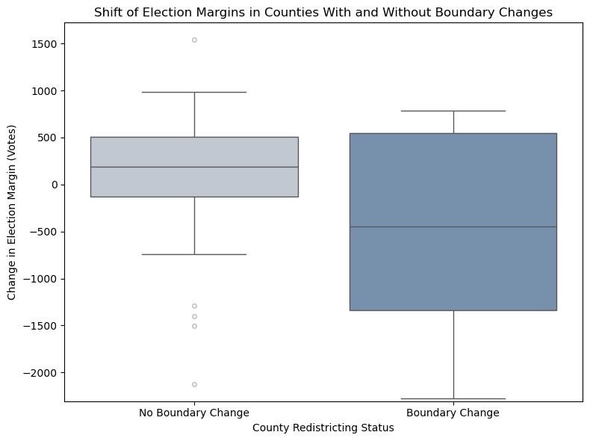
Distribution of Margin Shifts by Redistricting Status
Counties affected by congressional boundary changes show a wider and more asymmetric range of election margin shifts, while counties without boundary changes exhibit more centered and consistent outcomes.

Slide 13
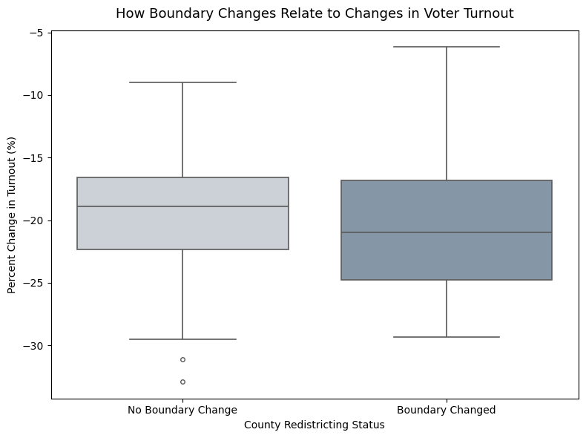
Turnout Changes
by Redistricting Status
Counties affected by congressional
boundary changes exhibit a broader and slightly lower distribution of turnout
change, suggesting greater variability in voter participation following
redistricting.

Slide 14
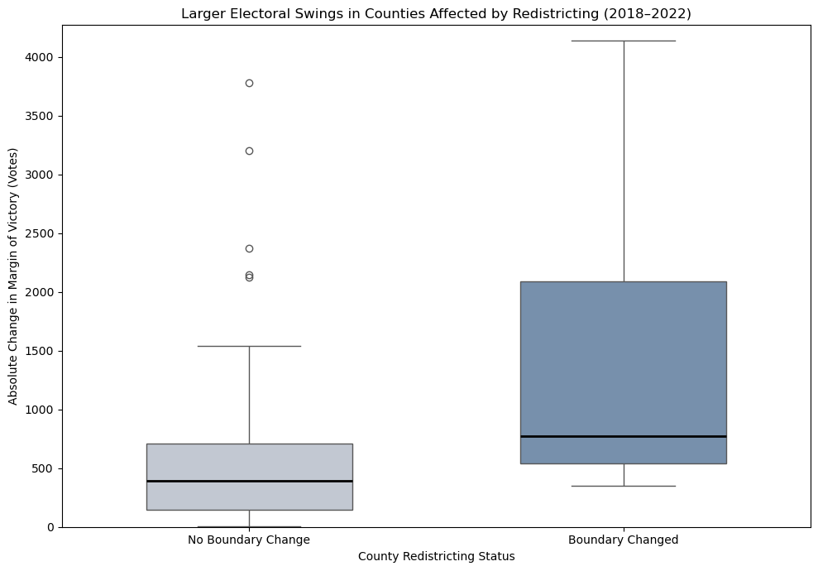
Magnitude of Electoral Margin Shifts
Counties affected by congressional
boundary changes experienced larger and more variable shifts in election margins,
indicating greater electoral volatility
following redistricting.

Slide 15
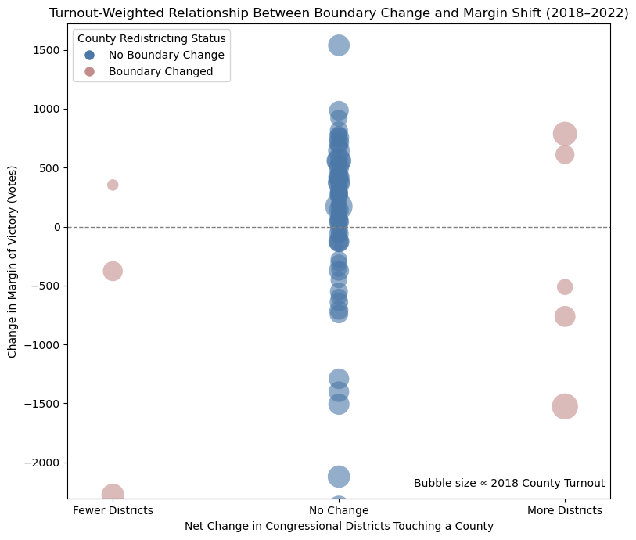
Turnout-Weighted
Margin Shifts
When county turnout is taken into account, larger margin shifts tend to occur in counties that experienced congressional boundary changes, indicating the electoral impact of redistricting.

Slide 16
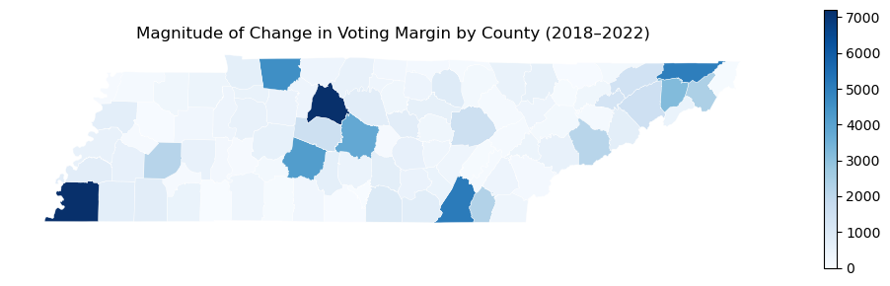
Geographic Concentration of Margin Change
Large shifts in voting margins are not evenly distributed across the
state, but instead cluster in specific counties, indicating that electoral volatility is geographically concentrated rather than uniform.

Slide 17
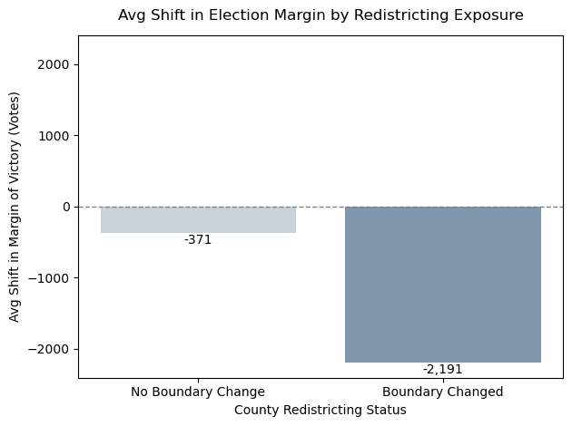
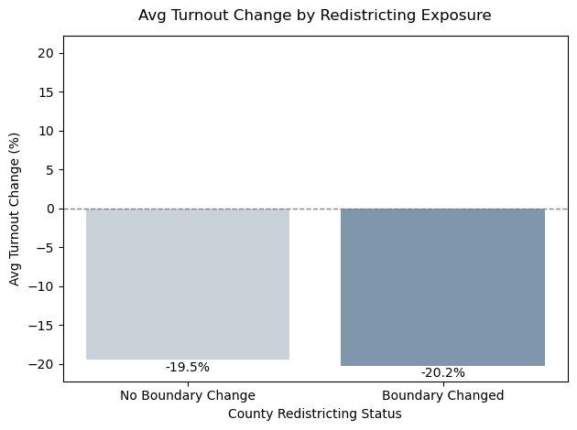
Average Electoral Shifts in Redistricted Counties
Counties affected by congressional boundary changes
experienced substantially larger average shifts in
election margins.
Changes in voter turnout remained similar regardless
of redistricting exposure.

Slide 18
Conclusion
Congressional redistricting altered how counties were divided across districts, increasing fragmentation in a subset of Tennessee counties.
Counties that experienced boundary changes showed greater variability in election margins between 2018 and 2022.
Margin shifts were often larger in magnitude in counties affected by redistricting, even when average changes were modest.
Changes in voter turnout were less consistently associated with redistricting exposure.
Overall patterns suggest redistricting is associated with structural electoral change, though not uniformly across all counties.

